Slide 1

B.E. Project Stage-I Presentation Report on BLOCKCHAIN-BASED CARBON CREDIT ECOSYSTEM
gUiDED BY
mrs. Parvati bhadre
Department of information technology (2019 course)
Dy patil college of engineering, akurdi, pune-44

Slide 2
Team Members
Roll No. | Exam Seat No. | Name
BE22IT071 | B1900808589 | Amol Netke
BE22IT072 | B1900808651 | Yogesh Zade
BE22IT074 | B1900808549 | Harsh Satwani
BE22IT076 | B1900808635 | Yuvrajsing Solanke

Slide 3
Contents
Introduction
Literature Review
Problem Statement
Objectives
Scope
System Architecture
System Implementation
Results
Conclusion & Future Scope

Slide 4
Introduction
What are Carbon Credits?
A carbon credit is a permit or allowance that grants industries the right to emit a specified amount of carbon dioxide (CO2) or equivalent greenhouse gases. Typically, one carbon credit allows for the emission of one ton of CO2.
These credits are part of a cap-and-trade system where companies that reduce their emissions can sell their excess credits to other companies that need them, creating a financial incentive to lower overall emissions.
Why it's important?
Carbon credits are vital in reducing greenhouse gas emissions but face inefficiencies and lack of trust in current systems such as:
Fragmented systems across regions
Lack of transparency
High transaction costs
Goal
To develop a transparent and efficient blockchain solution to improve the carbon credit system.

Slide 5
Literature Review
Sr. No. | Paper Name | Author(s) | Summary
1 | A Blockchain-based Carbon Credit Ecosystem | Dr. Soheil Saraji, Dr. Mike Borowczak | Proposes a blockchain ecosystem for carbon credits to improve transparency, standardize trading, and reduce transaction costs.
2 | Leveraging Blockchain in Energy Transition and Decarbonization | Dr. Surekha Deshmukh | Explores blockchain’s role in energy transition, peer-to-peer trading, and grid optimization for decarbonization.

Slide 6
Literature Review
Sr. No. | Paper Name | Author(s) | Summary
3 | A Digital Carbon Credits Ecosystem, Powered by Blockchain | Infosys Limited | Suggests using blockchain to create a unified and transparent carbon credit platform, improving pricing and reducing intermediaries.
4 | Leveraging Blockchain in Energy Transition and Decarbonization | Seong-Kyu Kim, Jun-Ho Huh | Focuses on using blockchain to verify carbon credits in alignment with the UN SDGs, using AI and big data for anomaly detection and verification.

Slide 7
Problem Statement
To develop a decentralized blockchain-based carbon credit system that ensures transparent, secure, and efficient tracking and trading of carbon credits, reducing fraud and costs while promoting trust and sustainability through automated processes.
Current Issues
Fragmented systems with inconsistent standards across regions.
Lack of transparency in issuing and trading carbon credits.
High transaction costs due to multiple intermediaries.
Need for a Solution
A decentralized, blockchain-based system to ensure transparency, security, and efficiency in carbon credit tracking and trading.
Reduce fraud, double-counting, and transaction costs while promoting trust and sustainability.
Automate processes to make the system more accessible and reliable.

Slide 8
Objectives
Enhance Transparency
Create a blockchain platform for full transparency in carbon credit tracking (issuance, trading, retirement).
Use smart contracts to automate and publicly record transactions, ensuring auditability.
Standardize Carbon Credit Systems
Establish consistent protocols for tokenizing, minting, and burning carbon credits globally.
Develop a universal digital standard for integration across industries and regions.
Reduce Transaction Costs
Minimize intermediaries by using a decentralized platform.
Automate trading and verification processes to cut administrative overhead.
Increase Accessibility
Design a user-friendly interface for all stakeholders (corporations, businesses, NGOs, individuals).
Support global participation with multi-language options and regional compliance.

Slide 9
Scope
Global Reach
The system will be designed to operate across different regions and regulatory environments, enabling global participation in carbon credit trading.
Stakeholder Inclusion
The platform will cater to a wide range of stakeholders, including corporations, small businesses, NGOs, and individuals, ensuring accessibility for all.
Interoperability
It will support integration with existing carbon credit markets and platforms, ensuring a seamless connection with global initiatives.
Scalability
The platform will be scalable to handle increasing volumes of transactions and participants as the market grows.

Slide 10
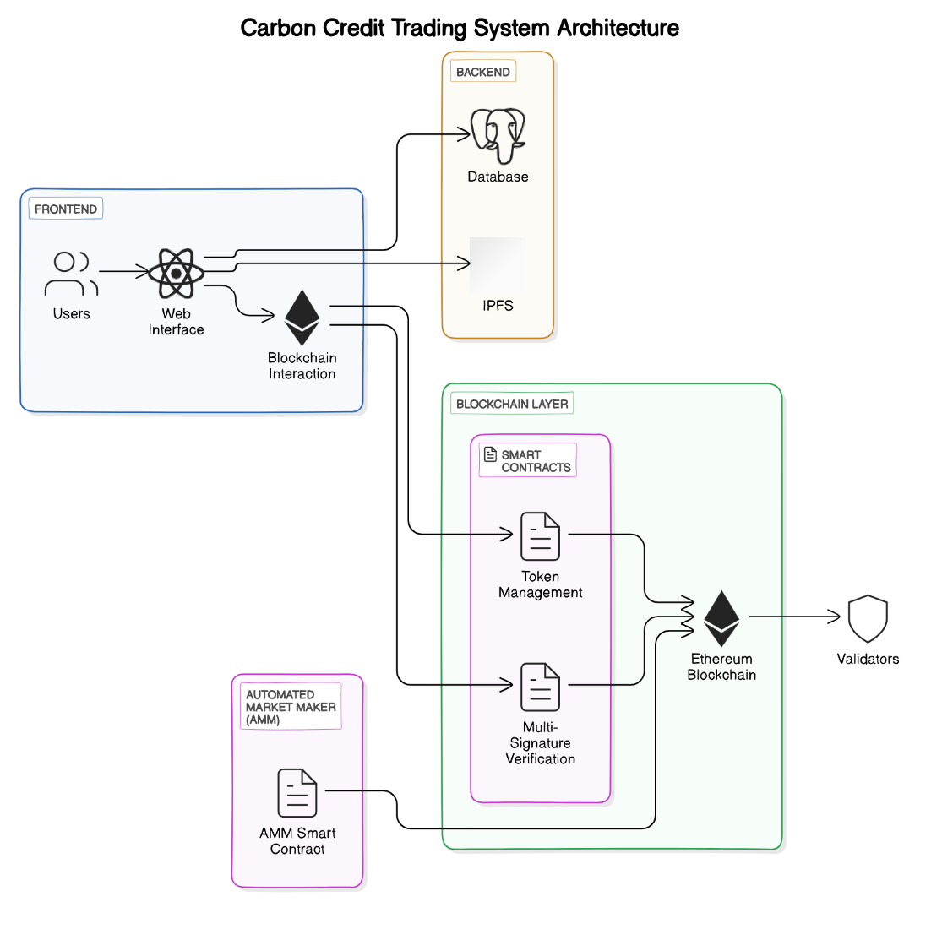
System Architecture

Slide 11
System Architecture
Key Stakeholders in the Ecosystem
Generators: Entities generating carbon credits (e.g., wind farms, reforestation projects).
Consumers: Carbon emitters, such as energy companies, purchasing credits.
Validators: Accredited experts validating carbon credits and onboarding projects.
Core Process Flow
Tokenization: Carbon credits are converted into digital tokens on the blockchain after validation.
Trading Platform: Decentralized exchange allows trading of carbon tokens, with prices determined by supply and demand.
Burning Mechanism: Carbon tokens are retired (burned) using a "buy and burn" model. Successful burns reward participants with NFTs (Carbon Removal Certificates).

Slide 12
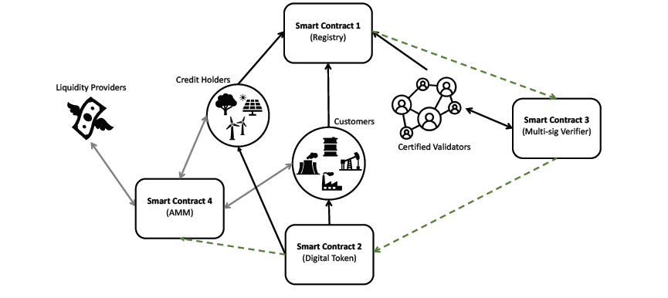
System Architecture
Smart Contracts Overview
Smart Contract 1: Registry System
Records information for verifiers, credit-holders, and customers.
Smart Contract 2: Token Management
Approves, mints, transfers, and burns carbon tokens.
Smart Contract 3: Multi-Signature Verification
Facilitates the verification of carbon token minting and burning. Requires approval from 70% of verifiers.
Smart Contract 4: Automated Market Maker (AMM)
Automates trading of carbon tokens with digital currencies. Incentivizes liquidity providers with transaction fees and provides dynamic pricing..

Slide 13
System Architecture
Frontend
User Dashboard
Centralized view of activities, including carbon credits, tokens, and transactions.
Carbon Credit Management
Interfaces for generators to submit projects and for buyers/sellers to trade tokens.
Verification and Validation
Dashboards for validators to review credits, with an audit trail for transparency.
Marketplace Interaction
Integration with AMM for trading and viewing liquidity pools.
Security Features
Secure login with multi-factor authentication and encrypted data.

Slide 14



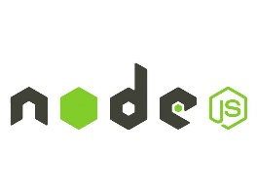
System Architecture
Tech Stack Overview
Blockchain Platform: Ethereum – Provides a secure environment for deploying smart contracts and managing carbon credits.
Smart Contract Development: Solidity – Language for writing smart contracts.
Development Frameworks : Truffle – Framework for managing and deploying smart contracts.
Front-End Integration: web3.js – JavaScript library for interacting with the Ethereum blockchain.
Automated Market Maker (AMM): Uniswap Protocol – Facilitates automated trading and liquidity provision for carbon tokens.
APIs: Integration APIs – Connect with existing carbon credit registries and other systems.

Slide 15
System Implementation
Setting Up the Blockchain Environment:
o Install the Ethereum development framework (e.g., Truffle or Hardhat).
Developing the Web and Mobile Applications:
o Set up the React.js application for the web interface.
Integrating Smart Contracts:
o Use web3.js to interact with the deployed smart contracts from the web and mobile applications.
o Implement necessary functions for issuing, trading, and retiring carbon credits.
Testing:
o Conduct unit testing for smart contracts using tools like Mocha and Chai.
o Perform end-to-end testing for the web and mobile applications.
Deployment:
o Deploy the web application on a cloud platform (e.g., AWS, Heroku).
o Publish the mobile application on app stores (Google Play Store and Apple App Store).

Slide 16
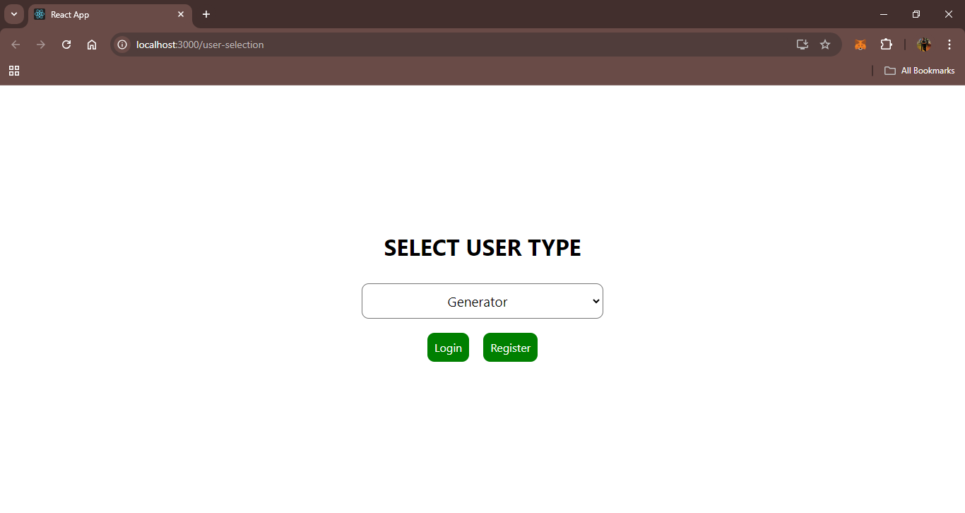
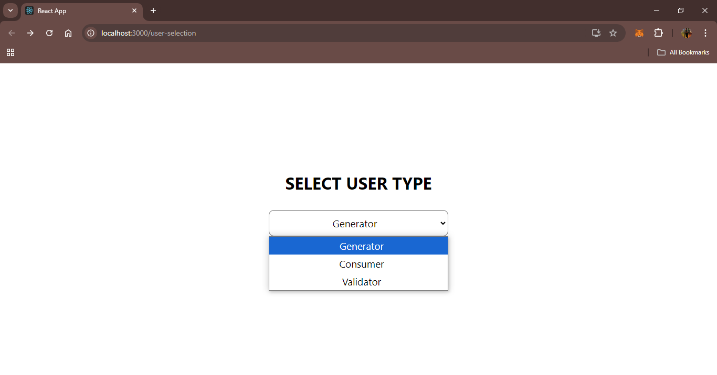
Results

Slide 17
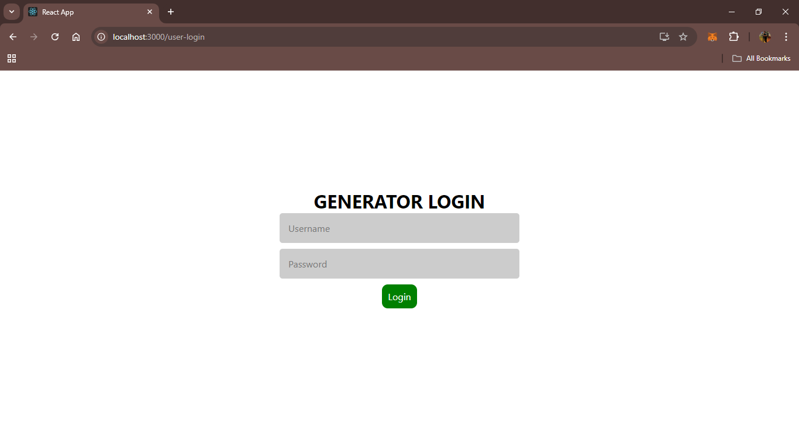
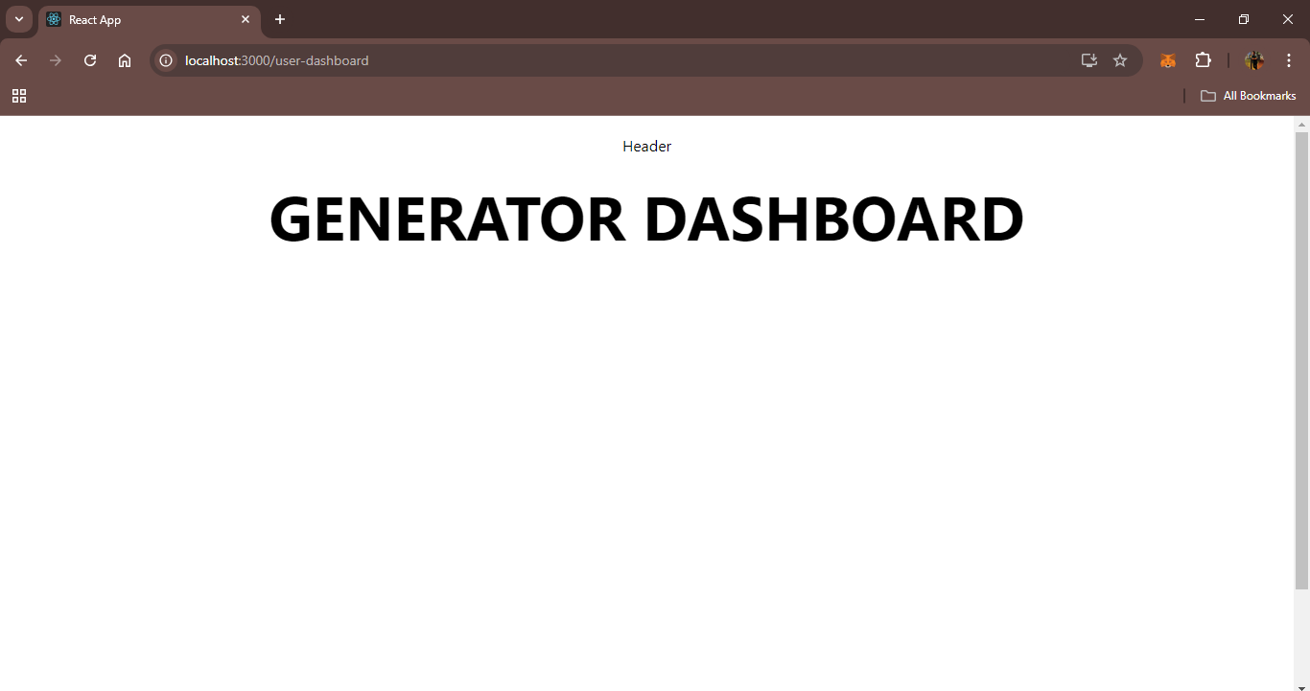
Results

Slide 18
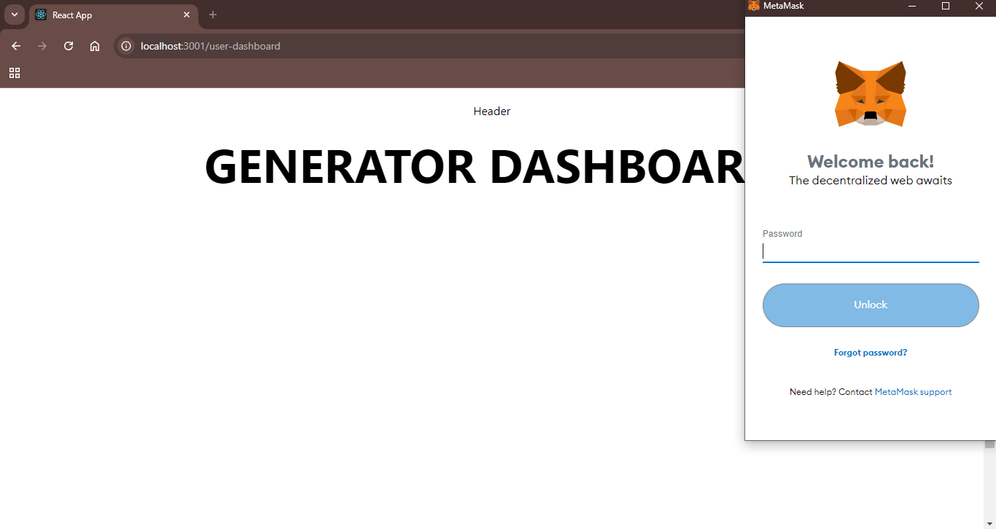
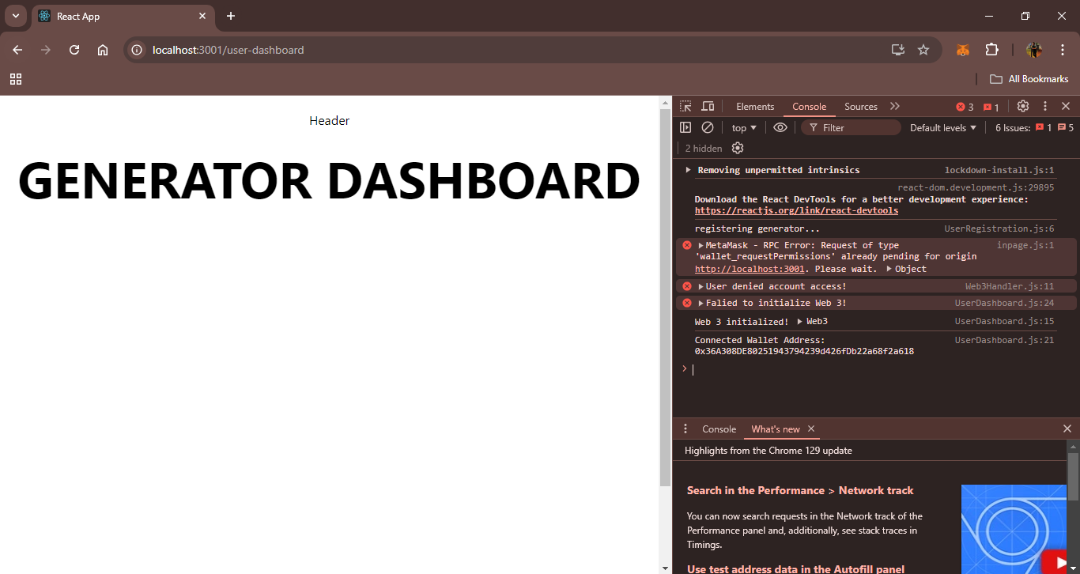
Results

Slide 19
Conclusion & Future Scope
Conclusion
Enhances transparency, efficiency, and security in carbon credit management.
Addresses fraud, verification inefficiencies, and transparency issues in the current market.
Automates the entire lifecycle of carbon credits with real-time monitoring using IoT and oracles.
Decentralized marketplace enables peer-to-peer trading, improving liquidity and reducing costs.
Future Scope
Potential for wider adoption, driving innovation in the carbon credit market.
Integration of advanced IoT devices and data oracles for more accurate environmental impact monitoring.
Expansion of the decentralized marketplace to include more participants and foster global collaboration.
Further development can accelerate global carbon offsetting and sustainability efforts.

Slide 20
Thank You!

